Slide 1

A
PROJECT REPORT ON
“Online Attendance System”
Submitted for the partial fulfillment of the Degree of Bachelor of Engineering in Computer awarded by Pokhara University
SUBMITTED BY
Nikit Pandey [21070562]
Ranjan Paudel [21070565]
Suman Sharma [21070579]
Shiva Kumar Bhandari [21070575]
SUPERVISOR
Er. Safal Thapa
SUBMITTED TO:
DEPARTMENT OF COMPUTER ENGINEERING POKHARA ENGINEERING COLLEGE
PHIRKE, POKHARA-8 2024

Slide 2
CERTIFICATE
Date: 2024/07/01
This is to certify that the project entitled “Online Attendance System” has been carried out by Nikit Pandey (21070562), Ranjan Paudel (21070565), Suman Sharma (21070579) and Shiva Kumar Bhandari (21070575) in partial fulfillment of the degree of Bachelor of Engineering in Computer of Pokhara University, during the academic year 2023. To the best of our knowledge and belief, this work has not been submitted elsewhere for the award of any other degree and thus has been accepted.
Er. Safal Thapa Project Supervisor
Er. Suraj Basant Tulachan HOD, Computer & Electronics
Er. Krishna Ghimire Research & Development Chief

Slide 3
ACKNOWLEDGEMENT
We would like to express our special thanks of gratitude to our teacher Er. Safal Thapa for his valuable guidance, encouragement and support to complete this project.
We are also thankful to our HOD Er. Suraj Basant Tulachan, , and whole college department for this golden opportunity.
Finally, we would like to thank to our friends and families for their support to help us finalize this project within the given time period.
Nikit Pandey [21070562]
Ranjan Paudel [21070565]
Suman Sharma [21070575]
Shiva Kumar Bhandari [21070579]

Slide 4
ABSTRACT
This report details the creation of an online attendance system to simplify and improve attendance tracking in schools. The system allows students to log in, mark attendance, and receive email notifications, while teachers and administrators can manage records through an admin panel. The system addresses issues with manual attendance like time consumption, errors, and data management difficulties. It provides quick, accurate, and real-time attendance records. The development process included requirement analysis, system design, development, testing, and deployment. The report also compares other methods, highlighting the benefits of this online system.

Slide 5
ABBREVIATIONS
ER: Entity-Relationship
PK: Primary Key
FK: Foreign Key
HTML: Hyper Text Markup Language
CSS: Cascading Style Sheets
JS: JavaScript
SQL: Structured Query Language
UI: User Interface

Slide 6
LIST OF FIGURES
ERDiagram…………………………………………………………………………………............................................................. 16
SequenceDiagram……………………………………………………………………………...................................................... 17
UseCaseDiagram……………………………………………………..........................................................…………………….. 18
Appendix………………………………………………………………………..................................................................…………... 24

Slide 7
LIST OF TABLES
Database Table for Attendance……….......................................…………………………………………… 19
Database Table for class………..........................................……………………………………..……………… 19
Database Table for Course………………………………………………….....................................................… 19
Database Table for Teacher…………………………………....................................................................... 20
Database Table for Student…………………………………………………………............................................. 20
Test Cases and Result………………………………………....................................................................... 21

Slide 8
TABLE OF CONTENTS
CERTIFICATE ............................................................................................................................ 2
ACKNOWLEDGEMENT............................................................................................................ 3
ABSTRACT ................................................................................................................................. 4
ABBREVIATIONS...................................................................................................................... 5
TABLE OF CONTENTS ..................................................................................................... 8
CHAPTER 1: INTRODUCTION.............................................................................................. 9
Background ................................................................................................................ 9
Statement of Problem............................................................................................... 10
Objective .................................................................................................................. 11
Scope of Project ....................................................................................................... 11
Limitation................................................................................................................. 11
CHAPTER 2: LITERATURE REVIEW ............................................................................... 12
Preliminary Study .................................................................................................... 12
Similar Tasks........................................................................................................... 12
CHAPTER 3: METHODOLOGY.......................................................................................... 13
CHAPTER 4: PROJECT SCHEDULE .................................................................................. 14
CHAPTER 5: SYSTEM MODELING................................................................................... 16
CHAPTER 6: TESTING ........................................................................................................ 21
CHAPTER 7: CONCLUSION ............................................................................................... 22
REFERENCE…………………………………..............................................……………………………............................... 23
APPENDIX………………………………………………………………………………….............................................................. 24

Slide 9
CHAPTER 1: INTRODUCTION
An online attendance system is a digital solution designed to manage and track the attendance of students in educational institutions. This report provides an overview of the system, including background information, the statement of the problem, objectives, scope, limitations, a literature review, and the methodology used for the development and implementation of the system.
Background
Social Aspects
In today's educational system, there is a growing importance on the integration of
technology to enhance learning experiences and simplify administrative tasks. The increasing use of digital platforms in education has made it essential for institutions to adopt efficient systems for managing student information, including attendance.
An online attendance system supports this trend by offering a modern, user-friendly interface that aligns with students' and teachers' familiarity with digital tools. It also fosters a culture of accountability and punctuality among students, as they are regularly reminded of their attendance status through automated notifications.
Economic Aspects
Implementing an online attendance system can lead to significant cost savings for educational institutions. Traditional methods of attendance tracking often involve
paper-based systems, which incur costs related to printing, storage, and
administrative labor. By transitioning to an online system, institutions can reduce these expenses and allocate resources more effectively. Additionally, the automation of attendance management minimizes the need for manual data entry and reduces the risk of errors, thereby improving overall operational efficiency. The initial investment in developing and deploying the system is offset by the long-term savings and increased productivity it provides.

Slide 10
Geographical Aspects
Geographically, the online attendance system is particularly beneficial for institutions
with multiple campuses or those located in remote areas. It allows for centralized management of attendance data, enabling administrators to monitor and analyze attendance patterns across different locations in real-time. For students in rural or remote areas with limited access to physical campuses, the system provides a convenient way to participate in classes and have their attendance recorded accurately. Furthermore, the system can be accessed from any location with an internet connection, making it versatile and adaptable to various geographical settings.
1.2. Statement of Problem
Manual attendance systems in educational institutions present several significant challenges:
Time-consuming and prone to errors, with difficulties in maintaining and organizing records.
Susceptibility to inaccuracies and manipulation, challenging the authenticity of recorded attendance.
Significant administrative effort required for compiling and analyzing attendance data, leading to delays in reporting.
Inability to monitor attendance in real-time, resulting in delays in identifying and addressing absenteeism patterns.
Manual systems struggle to scale with larger institutions, increasing complexity in managing attendance across multiple classes and departments

Slide 11
Objective
To create an easy-to-use attendance system for students, teachers, and admins.
To provide real-time data and facilitate easy data management.
To provide reminders to encourage improved attendance and engagement.
Scope of Project
Development of a web-based application: The application will be accessible from various devices including computers, tablets, and smartphones.
Student login functionality: Secure authentication for students to mark their attendance.
Attendance marking: Options for both manual and automated attendance marking.
Email notifications: Automated emails to notify students and administrators about attendance records.
Admin panel: For teachers and administrators to manage student records and generate attendance reports.
Limitation
The system needs a reliable internet connection to function properly.
Areas with poor connectivity may experience limitations.
Initial Setup Cost: There are upfront costs associated with developing and launching the system, which might pose financial challenges for some institutions.
User Training: Users, including students and staff, may require training to fully grasp and utilize the system effectively.

Slide 12
CHAPTER 2: Literature Review
2.1 Preliminary Study
The preliminary investigation of the project looked at whether it would be possible to develop an online attendance system for educational institutions. This involved examining existing attendance tracking methods, identifying challenges faced by teachers. Additionally, the study considered factors such as user requirements, data security, and system scalability. The insights gained from the study will help make informed decisions and plan the project effectively.
2.2 Similar Tasks
Several relevant projects and existing online attendance systems were reviewed during the literature review phase. These serve as valuable references for understanding the scope and possibilities within this domain. Notable tasks examined include:
AttendEasy: An online attendance system designed for educational institutions, offering features such as real-time tracking and customizable reporting.
ClassTrack: An attendance management system that integrates with available school systems, providing features like attendance recording and analysis.
AttendancePro: A cloud-based attendance tracking solution tailored for schools and universities, offering features such as biometric authentication and predictive analytics.
The literature review phase has provided valuable understanding of the existing research and projects in this field of online attendance systems. This knowledge serves as a foundation for developing this project, ensuring that it meets the needs of educational institutions and enhances attendance management processes.

Slide 13
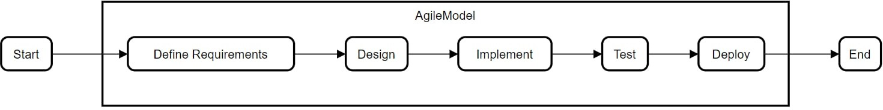
CHAPTER 3: METHODOLOGY
The Agile methodology is well-suited for this project due to its iterative and flexible nature. This approach allows for continuous feedback, quick adjustments, and constant improvement, which are essential for developing an effective online attendance system.
Requirement Gathering and Analysis : Meetings with stakeholders to understand needs and gather requirements.
Planning : Breaking down the project into tasks and creating a timeline. Design Creating wireframes, mockups, and system architecture.
Development : Developing the system in iterative sprints, implementing small sections at a time.
Testing : Performing various tests to ensure functionality and meet requirements.
Deployment : Deploying the system for real-world use and providing user training.
Maintenance and Feedback : Collecting user feedback, monitoring performance, and making updates.
Flowchart:

Slide 14
CHAPTER 4: Project Schedule
Estimated Timeline: 90Days
Phase 1: Project Planning and Preparation (12 days)
Define project requirements and objectives
Conduct research and gather relevant resources
Create a detailed project plan and timeline
Set up development environment and tools
Finalize project plan and prepare for implementation
Phase 2: Design and Prototyping (12 days)
Design wireframes for user interface
Develop mockups based on wireframes
Review and refine design with stakeholders
Create clickable prototypes for key user flows
Conduct usability testing on prototypes
Phase 3: Development Phase 1 (24 days)
UI development (HTML/CSS)
Build Interactive elements.
Ensure navigation and accessibility for users to record and view data.
Conduct testing and debugging of implemented features
Address any issues and refine codebase.
Phase 4: Development Phase 2 (24 days)
Handle user authentication, process attendance data on server side.
Validate user inputs, process attendance data and execute business logic.
Create database and integrate in order to store and manage records.
Conduct testing and debugging of new features
Address any issues and prepare for final deployment.

Slide 15
Phase 5: Finalization and Deployment (18 days)
Finalize remaining features and conduct comprehensive testing
Prepare for deployment, including setting up hosting environment.
Deploy the platform to a staging environment for final testing
Address any issues and prepare for final deployment.
Phases | March 12-24 | March/April 25- 5 | April 6- 30 | May 1-24 | May/June 25-13
Project planning and preparation
Design and Prototyping
Development Phase I
Development phase II
Testing and Debugging
Finalization and Deployment

Slide 16
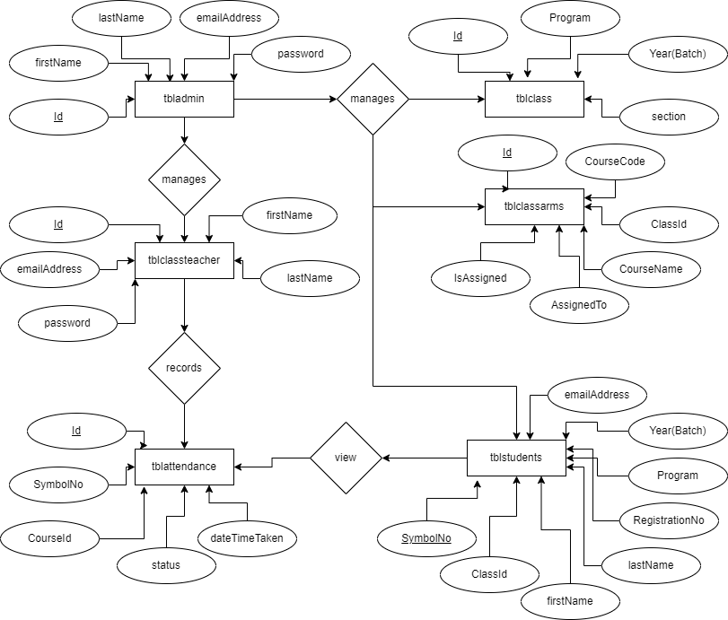
CHAPTER 5: SYSTEM MODELING
5.1. ER-Diagram
Figure: ER-Diagram

Slide 17
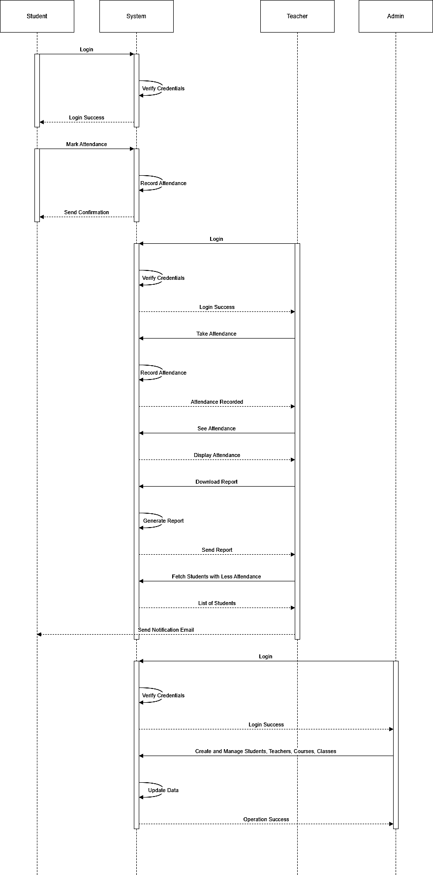
5.2. Sequence Diagram
Figure: Sequence Diagram

Slide 18
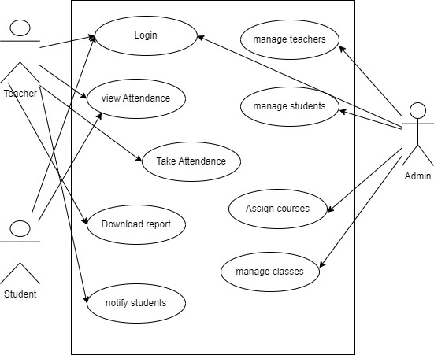
5.3. Use Case Diagram
Figure: Use Case Diagram

Slide 19
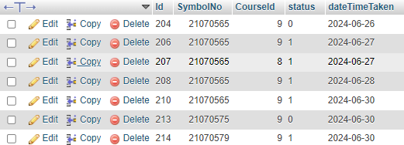


Database Design
Database Table for Attendance
Table1: Database Table for Attendance
5.4.2. Database Table for class
Table 2: Database Table for class
5.4.3. Database Table for Course
Table 3: Database Table for Course

Slide 20


5.4.4. Database Table for Teacher
Table 4: Database Table for Teacher
5.4.5. Database Table for Student
Table 5: Database Table for Students

Slide 21
CHAPTER 6: TESTING
6.1. Test Cases and Result
S.N | Testing Cases | Expectation | Obtained
1. | To ensure successful Login for Students, Teacher and Administrator | Users log in successfully | Users logged in successfully
2. | Taking attendance for different courses | Attendance can be marked for all courses | Attendance recorded for all courses
3. | To verify real-time update of attendance status | Attendance status updates immediately after marking | Attendance status updated in real time
4. | To verify alerts for absent students and send e-mail notification | Students with low attendance receive email | Email sent to students with low attendance
5. | To verify generation of attendance reports for a specific period | Attendance Report can be generated & downloaded | Report generated & downloaded successfully
6. | To ensure admin management of users and courses | Admin can update and create students, teacher, classes and courses | Users and courses managed successfully
Table 3: Testing activities and testing result

Slide 22
CHAPTER 7: CONCLUSION
Conclusion
The online attendance system addresses inefficiencies and inaccuracies in manual methods.
Agile methodology ensures flexibility and continuous improvement.
Automating attendance tracking reduces time and administrative effort.
Real-time data access and enhanced communication improve monitoring and transparency.
Despite limitations like internet dependency and initial costs, the system's benefits make it a valuable tool for educational institutions.
22

Slide 23
REFERENCE
Welling, L., & Thomson, L. (2009). PHP and MySQL Web Development
(4th ed.). Addison-Wesley Professional.
PHP: Hypertext Preprocessor. (n.d.). PHP Manual. Retrieved from https://www.php.net/manual/en/
Bootstrap Documentation. (n.d.). Retrieved from
https://getbootstrap.com/docs/
D. jQuery Documentation. (n.d.).
https://api.jquery.com/
E. StackOverflow, At https://stackoverflow.com/
Retrieved from
22

Slide 24
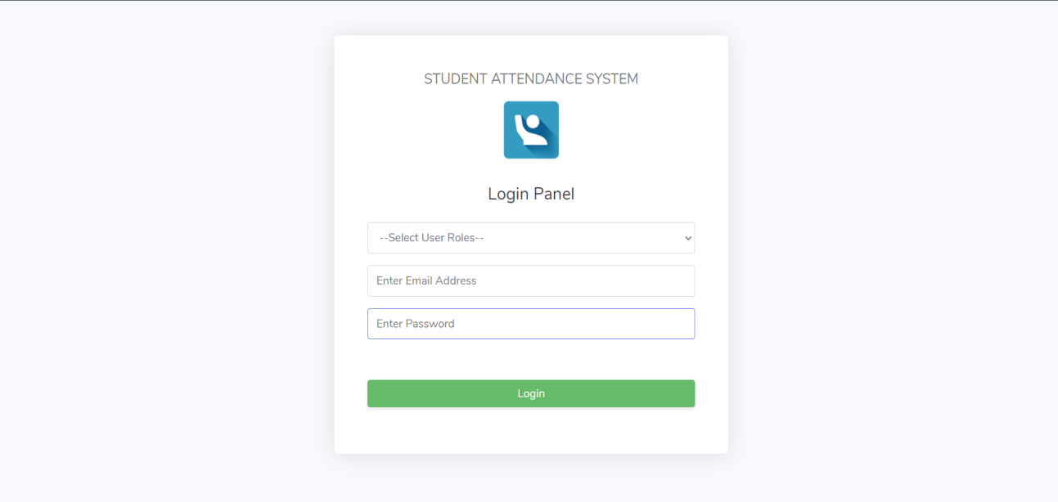
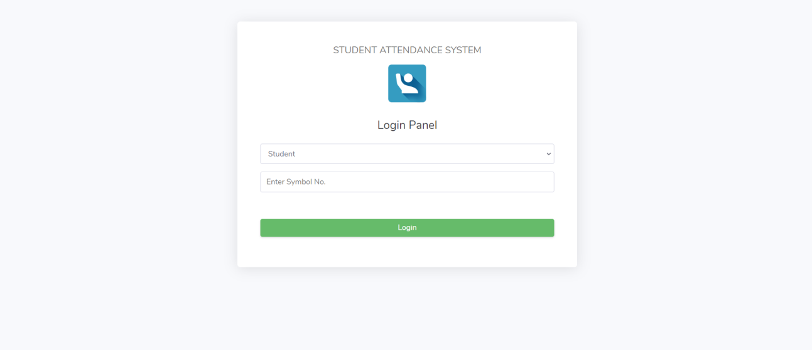
APPENDIX
A. Screenshot of login page
Appendix 1:
Screenshot of login page
B. Screenshot of Student login page
Appendix 2: Screenshot of Student login page
22

Slide 25
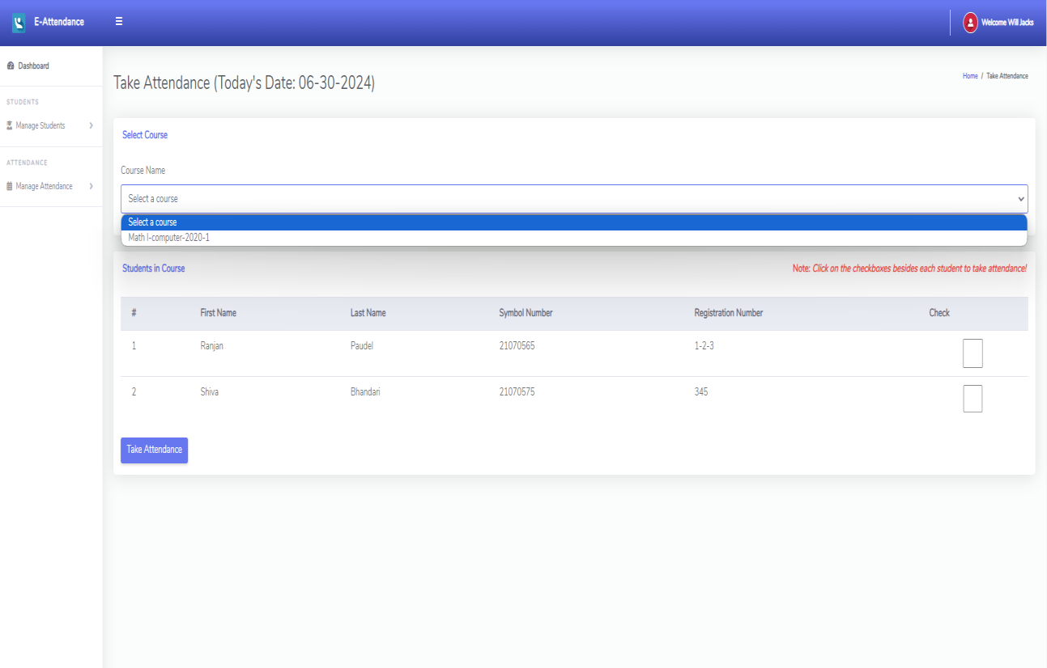
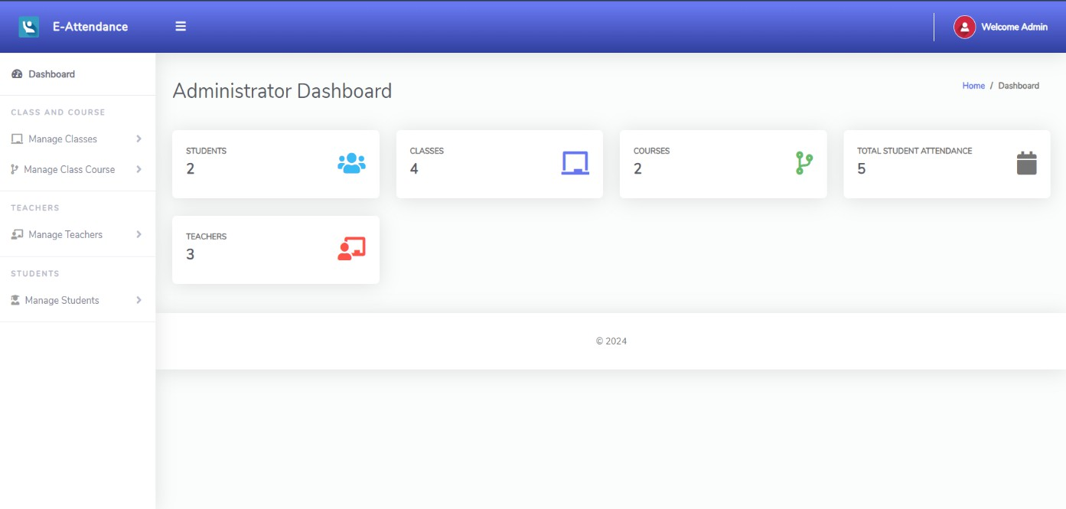
C. Screenshot of Take Attendance
Appendix 3: Screenshot of Take Attendance
D. Screenshot of Admin Dashboard
Appendix 4: Screenshot of Admin Dashboard
22

Slide 26
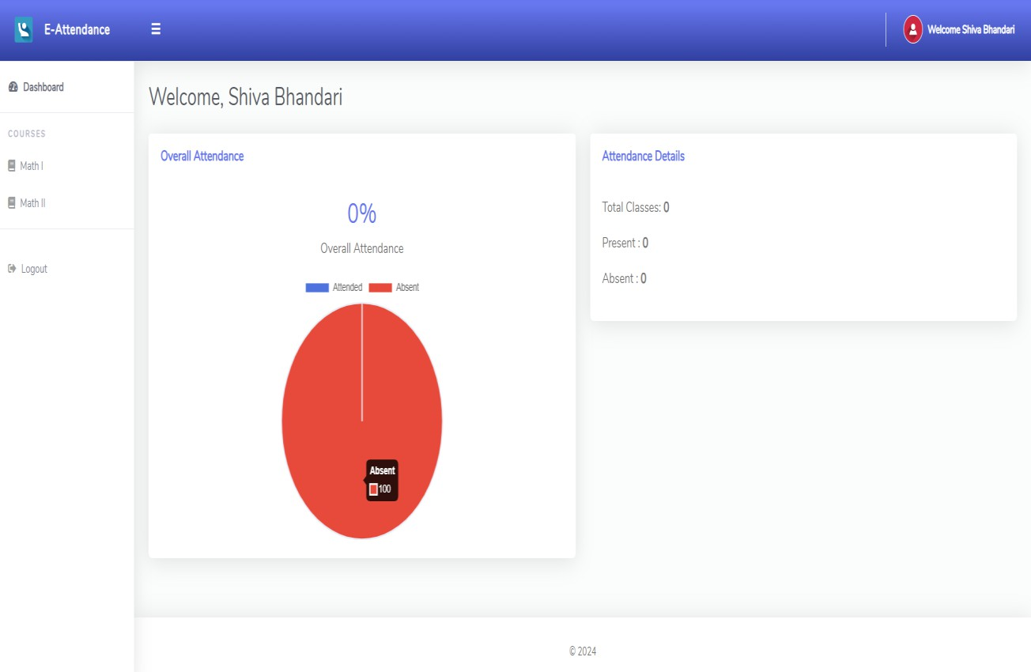
E. Screenshot of Student Dashboard
Appendix 5: Screenshot of Student Dashboard
22

